Slide 1
Gihan Shamike Liyanage

Slide 2
Answers
________yes_________ (Yes or No)
_______cisco__________
______enable___________
_________class________
_________conf t________

Slide 3
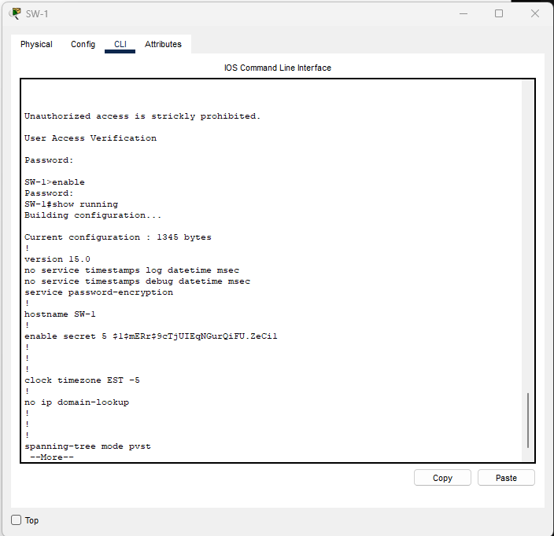
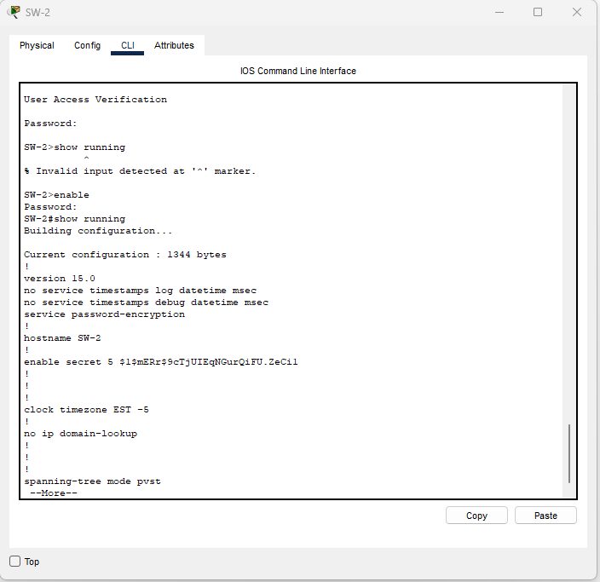

Slide 4
Answers
____No_______(But with show ip int b command)_10.10.10.110___
_______2 and 24________
______Yes_________
_______00d0.9732.2b8a________

Slide 5
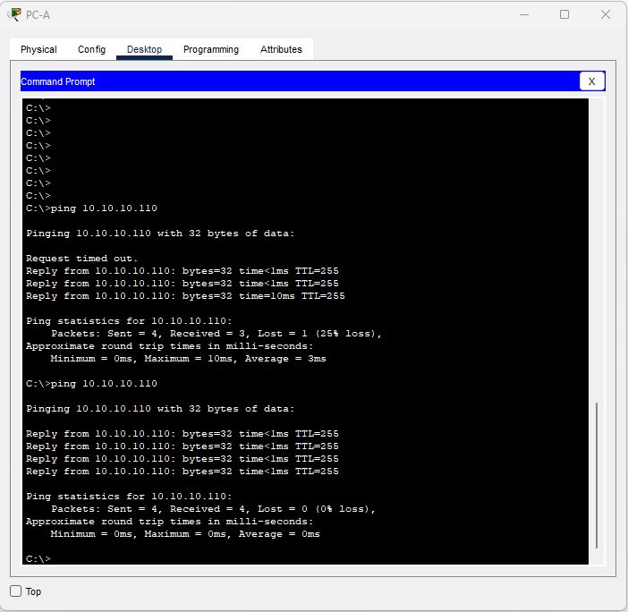
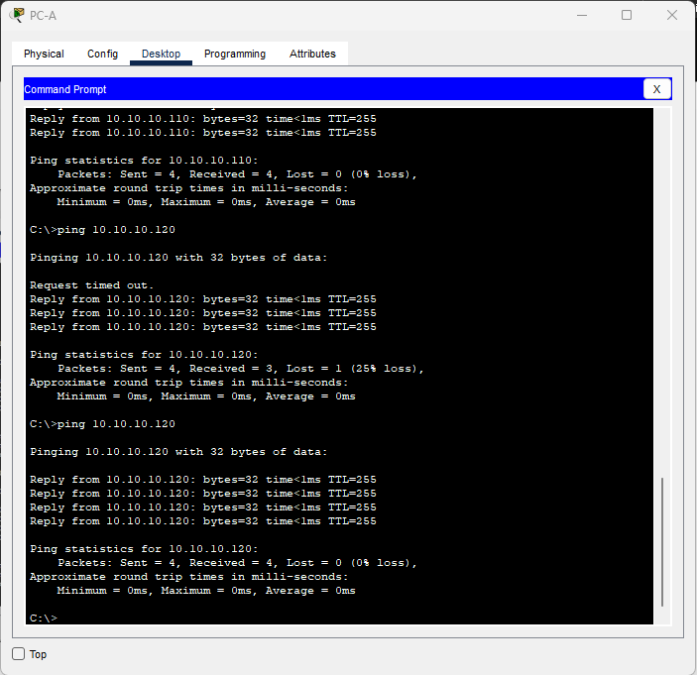

Slide 6
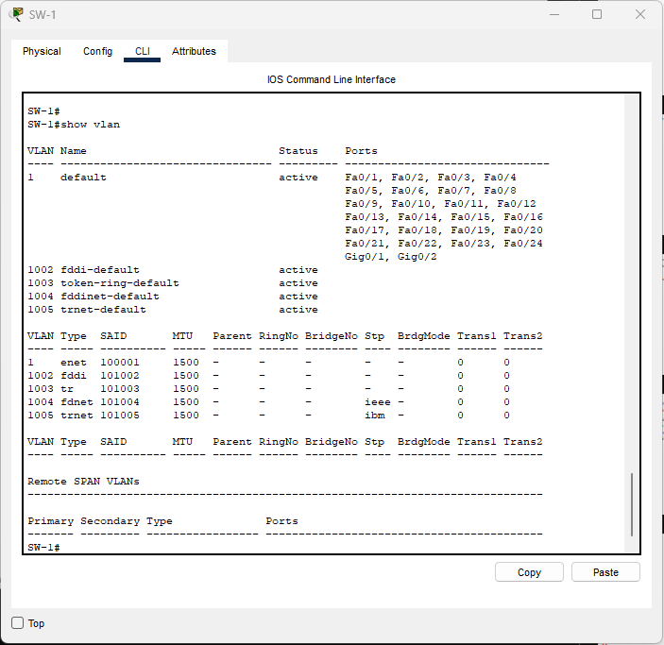

Slide 7
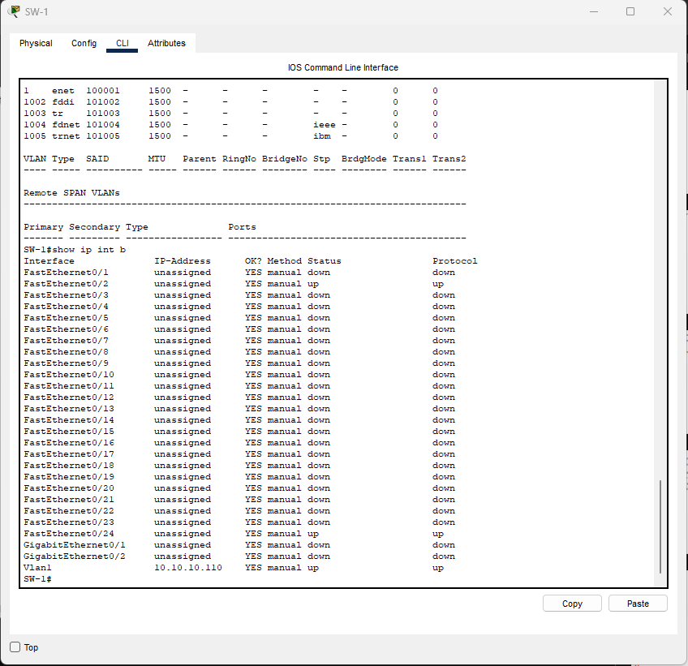

Slide 8
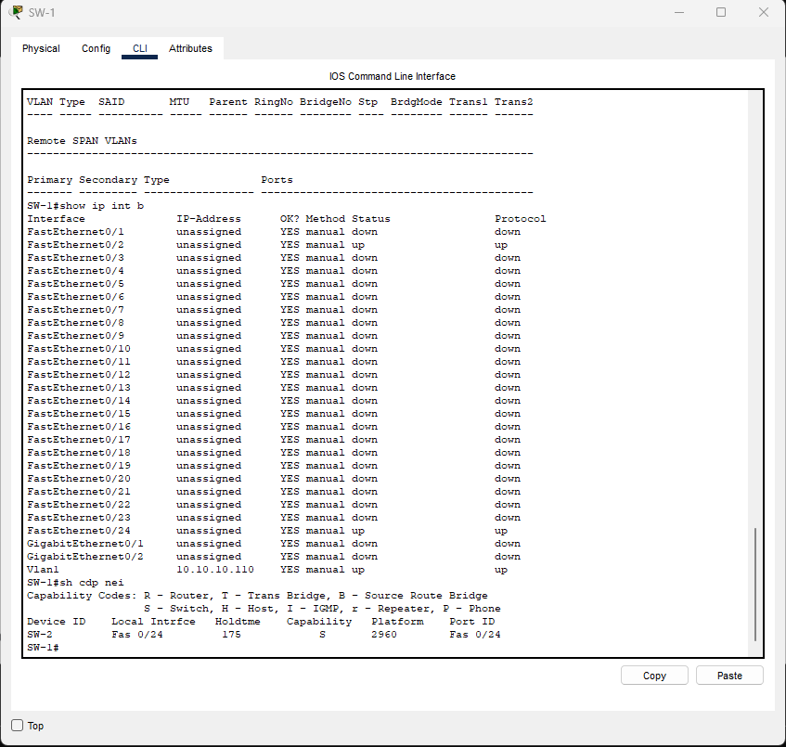

Slide 9
